Slide 1
Young Married Couple
Ray Caldwell
Notes:
This lesson is used with NTTC Workbook Exercise Ray Caldwell. It covers the following tax topics: Married Filing Joint filing status, Qualifying Relative, Income (dividends and IRA distribution), Other Income (prize and jury duty pay), Adjustments (educator expenses and jury duty repay), Credits (education and Credit for other Dependents), Other Taxes (additional tax on IRA with Form 5329).
Information for conducting this training lesson is contained in the Instructor Guide for Tax-Aide National Tax Training Committee Workbook (Workbook Instructor Guide)
Instructors should add, delete, or modify slides as necessary to meet their district training needs.
Instructors should direct the volunteers to review appropriate section of the Counselor Resource Guide (Pub 4012) whenever possible. If volunteers wish to take notes during class, they should note that Pub 4012 is a good place to record them.
Slides at the end of this presentation provide instructions for entering information for the various tax topic into TaxSlayer. Pub 4012 Tab O is emphasized as the best source for information on entering information into the software.

Slide 2
Young Married Couple
This lesson will focus on a tax return for a typical young married couple with dependents
The following tax topics will be discussed:
  Married (MFJ and MFS) and Qualifying Widow(er) Filing Statuses
  Qualifying Relative Dependent
  Income: Dividends, IRA Distribution, and Other (Prize and Jury Duty)
  Adjustments: Educator Expenses and Jury Duty Repayment
  Credits: Foreign Tax Credit, Education Credit and Credit for Other Dependents

Slide 3
Five Choices for Filing Status
Pub 4012 Tab B
Single
Married filing jointly (MFJ)
Married filing separately (MFS)
Head of household (HoH)
Qualified widow(er) (QW)
Notes:
Married Couples may choose to file jointly or separately. This lesson covers both MFJ and MFS filing Status as well as Qualifying Widow(er)

Slide 4
Filing Status: Married Filing Jointly (MFJ)
Married on last day of year
  Married and living together
  Living apart but not legally separated or divorced
  Separated but divorce decree not final
  Common law marriage does not apply in NJ
Spouse died during current year/not remarried
Generally, most advantageous filing status
Notes:
One return combining income and deductions of both spouses
On last day of year:
Married and living together
Living apart but not legally separated or divorced
Separated but divorce decree not final
Spouse died during year/not remarried

Slide 5
Filing Status: Married Filing Separately (MFS)
Why file MFS?
  Taxpayer chooses to file MFS
  Spouse has already filed MFS
  Married but separated and not filing MFJ
    Cannot file Single even if separated for years and does not know spouse’s location
Must provide spouse’s Social Security #
  If not known, file paper return with “Unknown” for SS #
Notes:
Some taxpayers believe that if they are no longer living together as husband and wife, that they can file as single. Once the taxpayer says they are married, the “Single” Filing Status can not be used even though the taxpayer has not seen their spouse for years and has no idea where they are.
Instructors should inform volunteers that this can occur when spouses have been separated for many years and the taxpayer does not know their spouses SSN. In this case a paper return must be filed with “unknown” written in for the SSN.

Slide 6

Filing Status: Decision Tree
Open
Pub 4012
to Page B-9
Don’t miss
the
footnotes
MFJ
MFS
QW
Notes:
Direct student to open Pub 4012 to Page B-7 and then lead the discussion
Don’t miss the footnotes

Slide 7
Filing Status: MFS - Disadvantages
Highest tax rate/lower standard deduction
Max social security taxable if lived with spouse at all during the year
Cannot claim most tax credits (EIC, education credits, credit for elderly or disabled)
Cannot deduct student loan interest
Cannot use standard deduction if spouse itemized
  Even if you file first‏
Notes:
MFS – Lived With Spouse Anytime During The Year
Cannot claim credit for the elderly or the disabled, cannot claim education credits, EIC
Must include social security benefits as income (up to 85% can be taxable)‏, unless lived apart the whole year

Slide 8
Filing Status: Qualifying Widow(er)
Spouse died in one of two past years
  Dependent* child and/or stepchild lived in home all year
  Grandchild not eligible
Maintained home (>50% of cost) for child
Can file QW for two years only
Advantages
  Standard Deduction – same as MFJ
  Uses MFJ tax rates
* Or would have been a dependent but for gross income, joint return, or taxpayer is a dependent tests

Slide 9
Dependent Exemption
Person other than taxpayer or spouse who entitles taxpayer to exemption:
  Qualifying child (which also includes adult with disability)
  OR
  Qualifying relative (which also includes qualifying non-relatives)
Notes:
In this lesson only the Qualifying Relative will be addressed

Slide 10
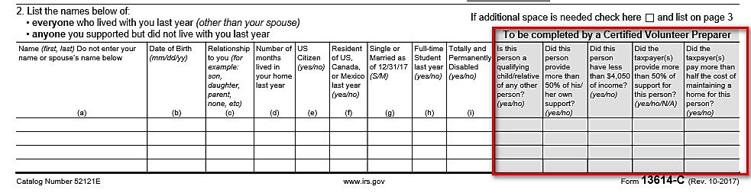
Intake and Interview – A review
Ask: Who else lived with you?
Who else did you support?
As necessary, get answers to questions in grey boxes and record them on the form
Notes:
Instructors should continue to reinforce proper use of the I&I Sheet including a careful, probing interview and completion of the gray shade boxes.

Slide 11
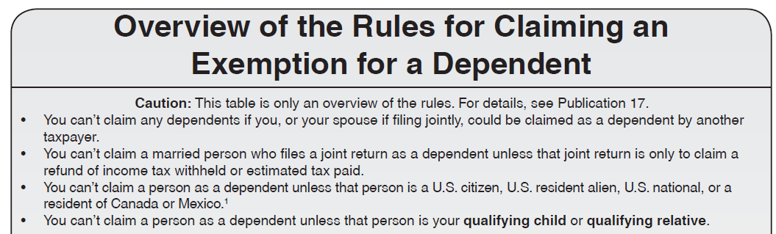
Dependency Exemption General Rules
Open Pub 4012 to Page C-1
Examine the general rules at the top

Slide 12
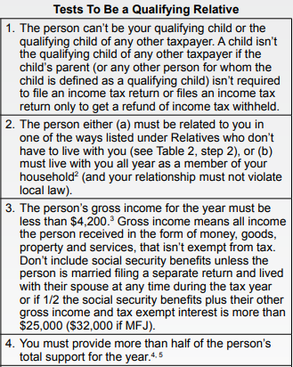
Qualifying Relative - Tests
Continue to examine Pub 4012 Page C-1
Review the Tests To Be a
Qualifying Relative
Also examine Tab C Table 2 for an
interview guide for these tests
Note the difference of the support tests
for Qualifying Relative vs Qualifying
Child
Notes:
The Instructor should lead the discussion as the class “walks down” the steps. After the review of the tests direct the class to Table 2 and point out the tests in an Interview format.
Instructors can also direct the class to examine the Qualifying Child/Relative Tool (Tri-Fold)

Slide 13

Questions
Answer Caldwell questions 1 - 5

Slide 14
Income: Dividends
Ordinary dividend income, not qualified
  Taxed at regular tax rates
Qualified dividend income
  A subset of ordinary dividends
  Taxed at capital gain rates
Notes:
Emphasize
Capital gains may be taxed at a lower rate than ordinary income
Rate can be as low as zero

Slide 15
Income: Dividends
Dividends are reported on:
  Form 1099-DIV
  Substitute 1099-DIV (brokerage or mutual fund statement)
  Schedule K-1 (later lesson)
Notes:
Emphasize
Many taxpayers have direct investments, not held in a brokerage account
Extra care is needed to make sure all are accounted for

Slide 16
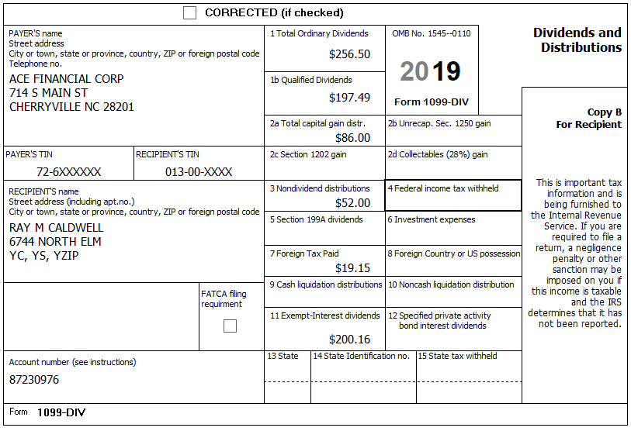
Income: Dividends - Form 1099-DIV
OOS
OOS
FATCA is out of scope
OOS
OOS
Notes:
Instructor should stress use of the Tax-Aide Scope Manual
Box 5 Investment expenses rarely seen on 1099-DIV form; more common with a brokerage statement and note that investment expenses can no longer be deducted on Schedule A

Slide 17
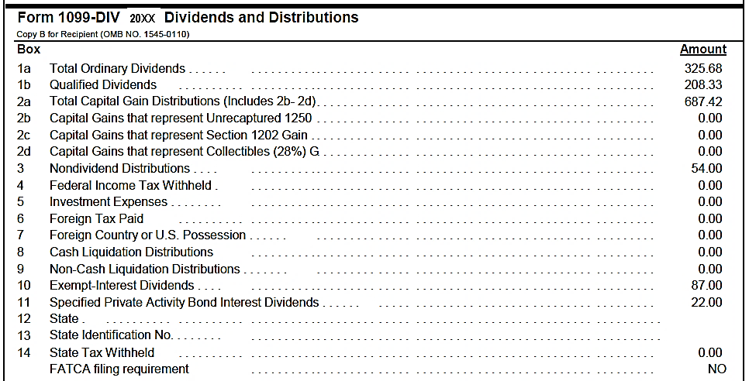
Income: Dividends – Brokerage Statement
Excerpt from sample brokerage statement
20XX
Lines 2c and 2d are out of scope
Lines 8 and 9 are out of scope
FATCA is out of scope
Notes:
Emphasize
Same as boxes on 1099-DIV
Box 2c Sec 1202 gains – out of scope
Boxes 8 and 9 Liquidation distributions – out of scope
Look out for state withholding

Slide 18
Income: Dividends - Capital Gain Distributions
1099-DIV Box 2a Capital Gain Distributions
Represent share of profit from sale of assets within mutual fund
  Always long term
  Taxed at capital gain rates
  TaxSlayer carries the entry to Schedule D
Notes:
If fund distributes short term gains, they are treated as dividends for federal tax purposes

Slide 19
Income: IRA Distribution
Four types of IRAs
  Traditional
  Roth
  Savings Incentive Match Plans for Employees (SIMPLE)
  Simplified Employee Pension (SEP)
Notes:
Traditional IRA
typically, fully deducted when contribution was made and therefor distribution is fully taxable
If not, need form 8606 Part I – look at prior year
Roth
Not deductible when contribution is made
Not taxable when distributed – IF rules are followed
SIMPLE/SEP A variation of a traditional IRA that may be partly or wholly funded by an employer
Typically, fully taxable when distributed

Slide 20
Income: IRA Distributions
Regular
Required minimum distribution (RMD)
  Amount that must be withdrawn from IRA by April 1 following year you turn 70 ½ and every subsequent year; 50% penalty if not withdrawn when required
Trustee to trustee transfer (not taxable)
  Transfer from one IRA account to another; taxpayer receives no money
Rollover (not taxable if done correctly)*
  Taxpayer removes money himself from one IRA account and redeposits it in another IRA account within 60 days
  Any withdrawn money not redeposited in another IRA account within 60 days is taxable
Notes:
Trustee-to-trustee: 100% not taxable (also referred to as “transfer”)
Trustee will normally not issue a 1099-R
If 1099-R is issued, should be code G (not taxable)
Can be done as often as taxpayer wishes
Taxpayer takes funds
Not taxable if rolled to another traditional IRA within 60 calendar days
Part not rolled is taxable
Possible additional tax if < 59½
Allowed one rollover in any 12-month period from the from any IRA to any IRA
From a company plan to an IRA or vice-versa, no limit

Slide 21
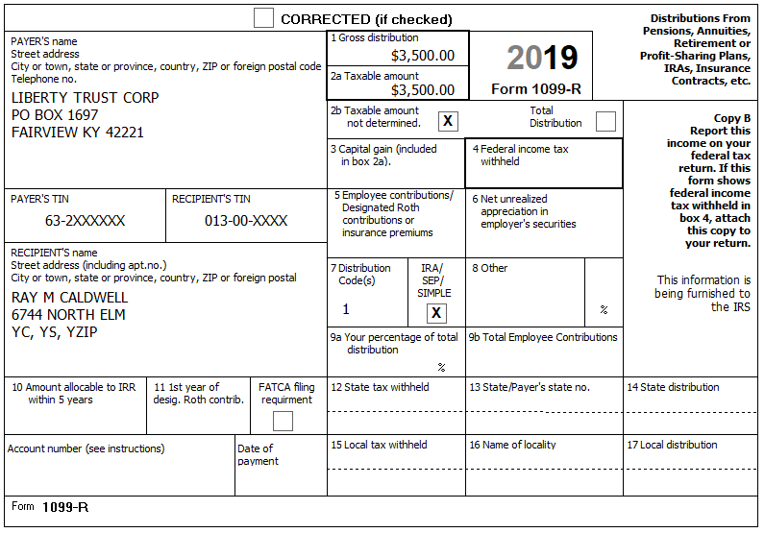
Income: IRA Distribution - Form 1099-R
Notes:
Box 1 – Gross distribution
Box 2a – Taxable amount – NOTE: If taxable amount is determined no further action is needed to determine taxable amount
If Taxable amount not determined is checked, Simplified General Rule calculation will be required.
Box 9b indicates employee contribution which will be used in the Simplified General Rule if taxable amount is not included in box 2a.
If box 2a is zero (not just blank), the distribution is non taxable . Correct Box 2a to read zero.)
Box 7 – Distribution code covered in one of next charts
Box 7 – Checked if IRA
Boxes 4 and 12 – Federal and State Income tax withheld
BOX 7 IS FIRST PLACE TO LOOK!

Slide 22
Income: IRA Distribution – Interview Questions
Traditional IRA
  Did taxpayer ever make non-deductible contributions?
    If no deduction taken for contribution, distribution may not be taxable when withdrawn (if rules followed)
  If early distribution, is there an exception to avoid additional tax?
    If money withdrawn from IRA prior to age 59 ½, could be 10% additional tax unless eligible for exception – see 4012 Page H-4 and slides 46-48
  If rollover was made, was it redeposited within 60 days?
  Was a qualified charitable distribution (QCD) made that might not be taxable?
    QCD is an otherwise taxable distribution from an IRA after 70 ½ that is paid directly from IRA to a qualified charity

Slide 23
Income: IRA Distribution – Interview Questions
Roth IRA
  Was any part of distribution originally a conversion from a traditional IRA to a Roth IRA? When?
    Determines taxability
  If early distribution, is there an exception to avoid additional tax?
  If rollover was made, was it timely?

Slide 24
Income: IRA Distribution – Interview Questions
SEP/SIMPLE IRA (less common)
  Confirm all is taxable
  If early distribution, is there an exception to avoid additional tax?
  If rollover was made, was it timely?

Slide 25
Income: IRA Distribution – 1099-R Box 7 Codes
Review Pub 4012 Tab D Form 1099-R Distribution Codes
Most commonly seen:
  1 – Early Distribution
  3 – Disability
  4 – Death
  7 – Normal Distribution
  G - Rollover
Always check the Tax-Aide Scope Manual if unsure whether 1099-R is in scope

Slide 26
Income: Other Income – A Review
Other Income includes miscellaneous income from a variety of sources
Review Pub 4012 Tab D Other Income Section
There may not be an IRS Form (e.g. 1099-MISC)
  Examples include: Prizes, honorarium, Jury Duty Pay, Poll Worker Income (if < $600 may not receive a form)
  Even if no form, must still report income as Other Income
Notes:
Instructors should stress always ask “Did you have any other income last year?”

Slide 27
Questions
Answer Caldwell questions 6 - 9

Slide 28
Adjustments: Educator Expenses
Review Pub 4012 Page E-3
  Up to $250 per educator
  For classroom materials or professional development expenses
  Must be K–12 teacher, counselor, principal or aide
  Must work in a school at least 900 hours during school year
Notes:
Direct Class to Pub 4012 Tab E to review requirements
PATH made deduction permanent
PATH added professional development expenses related to the curriculum
Expenses to meet minimum for a new job don’t count

Slide 29
Adjustments: Jury Duty Pay Turned Over to Employer
Some employers keep paying employee while they’re out on jury duty
Employee has to turn over all or part of jury pay received for those days
Must show jury pay received as Other Income (do not include expense reimbursements)
Claim an adjustment to reduce AGI for amount turned over to employer
Notes:
29
29
All other items on old line 35 are out of scope

Slide 30
Questions
Answer Caldwell questions 10 - 11

Slide 31
Credits: Foreign Tax Credit
Foreign taxes paid can be reported on 1099-INT, 1099-DIV, Schedule K-1, and Broker statements
Nonrefundable credit
  No benefit if there is no income tax
Simplified Method using Form 1116 is in scope if Total foreign tax is ≤ $300 ($600 MFJ)
If more than $300/600, taxpayer should see a paid preparer

Slide 32
Credits: Education Credits
Two Credits
  American Opportunity (AOC)—designed to cover first four years of post secondary education (college, etc.)
  Lifetime Learning (LLC)—designed to cover the rest of your life
Notes:
If a particular district sees a large number of taxpayers with education expenses, they may wish to have a separate, more detailed lesson on Education Benefits.

Slide 33
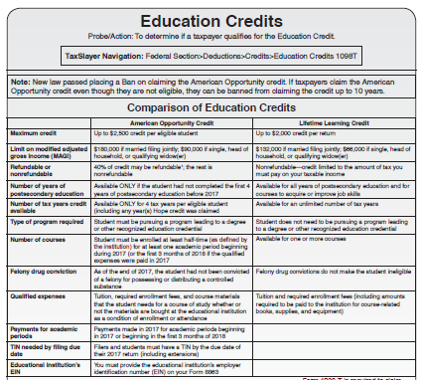
Credits: Education Credits
Examine Pub 4012 Tab J
Review the Education Credits pages
  Compare AOC and LLC
  Note who can claim the credit
  Note what expenses qualify
Notes:
Direct the class to open Pub 4012 to Tab J and examine the two Education Credits pages and lead a discussion of the two credits. The Caldwells will be claiming the AOC

Slide 34
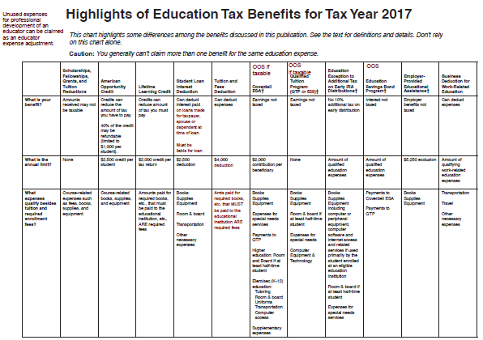
Credits: Education Credits
Examine Pub 4012 Tab J
Highlights of Education
Tax Benefits
Note the valuable
information available

Slide 35
Credits: Education Credits - Rules for Both Credits
Student must be taxpayer, spouse, or dependent
Student must not be claimed as dependent on another return
Student must be enrolled at eligible post-secondary school
Taxpayer cannot be filing Married Filing Separate (MFS)

Slide 36
Credits: Education Credits - Qualified Expenses
What expenses?
  Tuition and certain related expenses required for enrollment or attendance (not room and board expenses)
  Student activity fees paid to institution as condition of enrollment or attendance
Expenses paid by student considered paid by taxpayer
Costs paid by 3rd party are treated as paid by student
Notes:
Does NOT include student fees for personal expenses like dorm fees, health fees, or parking fees even if required for enrollment

Slide 37
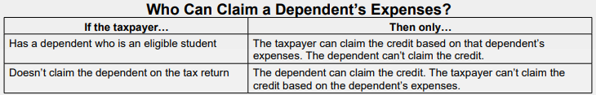
Credits: Education Credits - Qualified Expenses
Who can claim education credit?
Notes:
Does NOT include student fees for personal expenses like dorm fees, health fees, or parking fees even if required for enrollment

Slide 38
Credits: Education Credits - AOC
Credit worth up to $2,500 per student
  100% of first $2,000 of expenses
  25% of second $2,000 of expenses
  Generally 40% refundable*; rest is non-refundable
*Not refundable if student under age 24 and meets certain requirements (4012 Page J-9)

Slide 39
Credits: Education Credits - AOC
Can be taken only four tax years
First four years of academic credit after high school
Student is a candidate for a degree (includes certificate or other credential)
Minimum of half-time workload as set by school for at least one term
No felony drug convictions
Phased out for AGI greater than $80,000 ($160,000 MFJ)

Slide 40
Credits: Education Credits - AOC
Qualified expenses include course-related books, supplies and equipment (computer is considered qualified expense)
  Can be purchased anywhere
Notes:
Course Material must be required but can be purchased anywhere.
½ normal full-time defined by institution – See 1098-T later.

Slide 41
Credits: Education Credits - LLC
Credit worth up to $2,000 per RETURN, no matter how many eligible students
  20% of first $10,000 of expenses
  Not a refundable credit
Felony drug conviction not a disqualifier

Slide 42
Credits: Education Credits - LLC
No limit on number of years
No minimum amount of course workload
Not required to pursue a degree
  If not toward a degree, must be to acquire or improve job skills

Slide 43
Credits: Education Credits - LLC
Qualified expenses include tuition and fees only
  Books only if MUST be purchased from school as a condition of enrollment
Phased out for AGI greater than $55,000 ($110,000 if MFJ)

Slide 44
Credits: Credit for Other Dependents
$500 non-refundable credit
For dependents who do not qualify for the Child Tax Credit
  E.g. - dependent parent or sibling
  - dependent child who is age 17+
  - dependent child who does not have Social Security #

Slide 45
Questions
Answer Caldwell questions 12 - 15

Slide 46
Other Taxes: Additional Tax on IRAs
Distributions before age 59½ are an “early distribution”
Reported on Form 1099-R with Code 1 in Box 7
10%* additional tax
There are exceptions which requires Part I of Form 5329
* 25% for SIMPLE IRAs

Slide 47
Other Taxes: Additional Tax on IRAs - Form 5329
Review Pub 4012 Page H-4 Form 5329 pages
Note the exceptions to the 10% additional tax
  Note some apply to IRAs only and some do not apply to IRAs
Common exceptions are:
  03 - Due to total and permanent disabled (must be disabled at time of distribution)
  05 - The amount paid for medical expenses, minus > 10% of AGI*
  08 -The amount paid during the year for qualified education expenses (including room and board)*
* Distributions do not have to be specifically for stated expenses, but distribution and expenses must occur in same tax year

Slide 48
Other Taxes: Additional Tax on IRAs - Form 5329
Other parts of Form 5329 are out of scope:
  Part II: 10% tax on education and ABLE accounts
  Parts III – VIII: 6% tax on excess contributions to various qualified accounts not removed by due date of return
Notes:
Excess contributions can either be withdrawn, including earnings thereon
Or can be “used up” by not making an otherwise allowable contribution to the IRA
Applies to Traditional IRA and Roth IRA separately
6% applies to traditional IRAs, Roth IRAs, education savings accounts and medical savings accounts

Slide 49
Questions
Answer Caldwell questions 16

Slide 50
Supplemental Lesson on Self-Employment Income
Is it a business?
  There are 3 choices
  A business
  Income producing, but not a business
  Not entered into for profit (e.g. hobby)

Slide 51
A Business
Facts and circumstances:
  Profit motive
  Reasonable expectation of profit
  Means of livelihood
  Regular activity
  Conducted in a business-like manner
Notes:
One-time payments may or may not be a business
Sporadic activity may not be a business – but once a year, every year might be a business
Income cannot be on a W-2 – except statutory employees

Slide 52
Income Producing, Not a Business
Facts and circumstances:
  Sporadic activity, e.g., one-time fee
  Gambling winnings
  Investing
  Sale of personal assets (e.g. yard sales, Craig’s list, etc.)
Notes:
One-time payments may or may not be a business
Sporadic activity may not be a business – but once a year, every year might be a business

Slide 53
Not Entered Into for Profit
Facts and circumstances:
  Model airplane contest
  Beer mug collecting
  Antique hunting, when not a business
Usually, more pleasure driven than income driven
Not-for-profit activities are out of scope
Notes:
If this is an issue for your district here are the business vs. hobby criteria:
1. The manner that a taxpayer carries on an activity.
2. The expertise of a taxpayer or advisor(s) involved in the business activity.
3. The time and effort a taxpayer allocates to the activity.
4. Has the taxpayer had success with similar or dissimilar activities in the past?
5. The history of income/loss for the activity.
6. Are there occasional profits and, if so, how much are they?
7. The financial status of the taxpayer, and does the taxpayer rely on this business activity or does the taxpayer have other sources of income?
8. Is there an expectation of asset appreciation for any assets involved in the business activity?
9. Are there elements of personal pleasure or recreation?

Slide 54
The Interview
A conversation
Notes:
Encourage counselors to ask probing questions
It is not “prying,” it is essential to an accurate return

Slide 55
The Interview – A Conversation
Prior year return
Nature of business
Where is business conducted
Net profit or loss
Assets used in business
Record of income and expenses
Notes:
Steps and questions to determine whether in scope, before touching the computer
Ask participants why is the step performed or the question asked
Prior year’s return – a loss? too many expenses? Employees? 1099 payments to others?
Nature – is it really a business? Is there inventory?
Where – no office in the home
Loss this year?
Assets that can be depreciated or are eligible for immediate write-off require Form 4562 – out of scope
No records – need to determine whether business is legitimate and whether return can be prepared
Review how good records help taxpayers:
Monitor the progress of their business
Prepare their financial statements
Identify source of receipts
Keep track of deductible expenses
Prepare tax returns
Support items reported on tax returns
Ask: What are examples of business-related supporting documents?
Answers include: Sales slips, paid bills, invoices, receipts, deposit slips, canceled checks

Slide 56
Requirements for Business Income to be In Scope
Business expenses of $25,000 or less per Schedule C
Cash method of accounting (not accrual method)
No inventory
Must materially participate in business
No net loss from business
No employees or paid contract labor
Notes:
Steps and questions to determine whether in scope, before touching the computer
Ask participants why is the step performed or the question asked
Prior year’s return – a loss? too many expenses? Employees? 1099 payments to others?
Nature – is it really a business? Is there inventory?
Where – no office in the home
Loss this year?
Assets that can be depreciated or are eligible for immediate write-off require Form 4562 – out of scope
No records – need to determine whether business is legitimate and whether return can be prepared
Review how good records help taxpayers:
Monitor the progress of their business
Prepare their financial statements
Identify source of receipts
Keep track of deductible expenses
Prepare tax returns
Support items reported on tax returns
Ask: What are examples of business-related supporting documents?
Answers include: Sales slips, paid bills, invoices, receipts, deposit slips, canceled checks

Slide 57
Requirements for Business Income to be In Scope
Business has only one sole proprietor
Not a bartering business
No depreciation/amortization
No deduction for business use of home (home office). This includes the “simplified option for home office deduction”
No prior year disallowed passive activity loss
Notes:
Steps and questions to determine whether in scope, before touching the computer
Ask participants why is the step performed or the question asked
Prior year’s return – a loss? too many expenses? Employees? 1099 payments to others?
Nature – is it really a business? Is there inventory?
Where – no office in the home
Loss this year?
Assets that can be depreciated or are eligible for immediate write-off require Form 4562 – out of scope
No records – need to determine whether business is legitimate and whether return can be prepared
Review how good records help taxpayers:
Monitor the progress of their business
Prepare their financial statements
Identify source of receipts
Keep track of deductible expenses
Prepare tax returns
Support items reported on tax returns
Ask: What are examples of business-related supporting documents?
Answers include: Sales slips, paid bills, invoices, receipts, deposit slips, canceled checks

Slide 58
What if it is NOT a Business*
Income goes to Other Income
Deductible items go on Schedule A Itemized Deductions, if appropriate
* Activities not entered into for profit are out of scope
Notes:
Not-a-business – examples
unexpected pay for coaching a team
One time honorarium for speaking
contest winnings
once-a-year poll worker (often poll workers will receive a W-2 if income exceeds a certain amount)
Does not include “hobbies” that are not entered into for profit

Slide 59
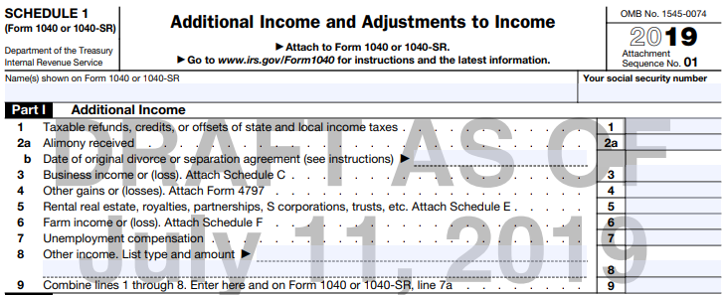
If it is a Business – Schedule 1 Line 3
Notes:
Business profits will go to Line 12 of the 1040
In the 1040 View, click on line 12 to access documents completed for Sch. C.

Slide 60
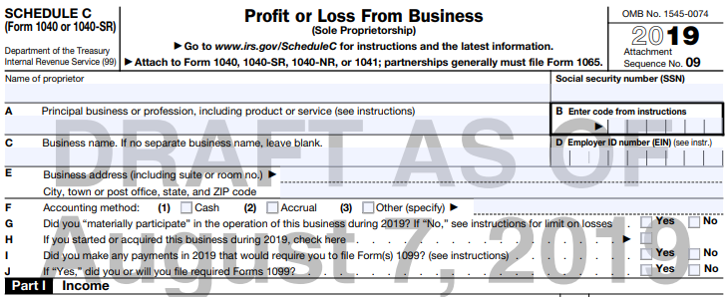
Schedule C
2018
Can have more than one Sch C if more than one business
  Do not combine businesses; if more than one business, need more than one Sch C
Notes:
The actual tax form

Slide 61
Business Income – 1099-MISC
Reported to Taxpayer on Form 1099-MISC
  Box 7: Non-employee compensation
  Box 3: Other income (?)
    Ask what income was for – payer may have used wrong box
Notes:
Consider the business.
Is it likely that the Taxpayer would have cash income?
If so, ask about it.
All Income must be reported.
All Form 1099-MISCs must be input into TaxSlayer as a 1099-MISC (not summarized to “other income”)

Slide 62
Allowable Business Expenses
Ordinary and necessary to the business
Not against public policy
  Cannot deduct fines or penalties
All allowable and documented expenses must be claimed
  Not claiming an expense may result in a tax benefit that would not otherwise occur (e.g., it may improve EIC). That is not allowed
Notes:
Review how good records help taxpayers: Refer to 4012 F-13
Monitor the progress of their business
Prepare their financial statements
Identify source of receipts
Keep track of deductible expenses
Prepare tax returns
Support items reported on tax returns
Ask: What are examples of business-related supporting documents?
Answer: Sales slips, paid bills, invoices, receipts, deposit slips, canceled checks.

Slide 63
Allowable Business Expenses
Pub 4491 Pages D-11
Advertising
Vehicle expenses
  Standard mileage only
Commissions
Insurance
Interest
Office & rent expense
Repairs & maintenance
Supplies
Taxes
Travel
Utilities
50% of business meals/entertainment
Professional fees
Notes:
63
Emphasize that if taxpayer claims standard rate for mileage, TaxSlayer will calculate the expense & include with other business expenses. If taxpayer wishes to claim actual expenses, the return is out of scope

Slide 64
Business – Car and Truck Expenses
Standard mileage deduction
  Only parking and tolls can be added
  All of the following are included in standard mileage
    Depreciation or lease payments
    Maintenance and repairs
    Gasoline (including gasoline taxes) or oil
    Insurance
    Vehicle registration fees

Slide 65
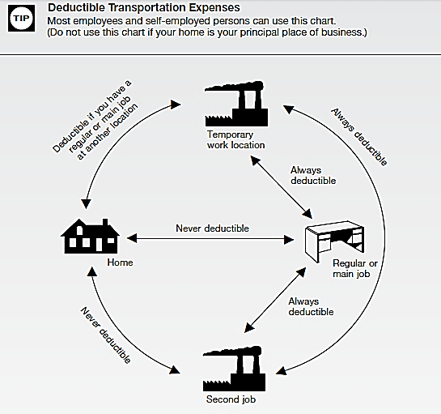
Business Mileage
Must understand
commuting versus
deductible travel
miles
  First and last trip of
  the day are commuting miles
  and cannot be deducted
  Travel in between 1st and
  last trip are deductible
See 4012 Tab D

Slide 66
Business Income
TaxSlayer will automatically flow business net profit to other parts of return:
  Self-employment tax
  Traditional IRA – use caution re Roth
  Earned income credit
  Qualified business income (QBI) credit

Slide 67
Self-Employment Taxes
If you have Self-Employment income on Schedule C, you must pay Social Security and Medicare taxes on that income
  Net income from self-employment must be over $400 to owe self-employment taxes
Social Security & Medicare tax rate on self-employment income is 15.3% (12.4% + 2.9%)
  Same as amount on employees’ wages, which is paid ½ by employer and ½ by employee
Entries on Schedule C will cause TaxSlayer to automatically:
  Calculate Self-Employment Tax on Schedule SE
  Record Adjustment to Income for ½ of Self-Employment Tax
Notes:
67
When a 1099-MISC is received with box 7 filled in (rather than a W-2), it indicates non-employee and must pay self-employment tax if income exceeds $400
TaxSlayer calculates the self-employment tax owed on 1040 Line 57
TaxSlayer calculates the amount that taxpayer can claim as an adjustment to income on Line 27 (one-half the self-employment tax)

Slide 68
Qualified Business Income
Individual taxpayers can deduct up to 20% of qualified business income (QBI)
  A deduction from AGI to arrive at taxable income
  In addition to standard or itemized deductions
Also referred to as Section 199A deduction
Notes:
68
When a 1099-MISC is received with box 7 filled in (rather than a W-2), it indicates non-employee and must pay self-employment tax if income exceeds $400
TaxSlayer calculates the self-employment tax owed on 1040 Line 57
TaxSlayer calculates the amount that taxpayer can claim as an adjustment to income on Line 27 (one-half the self-employment tax)

Slide 69

Young Married Couple – NJ Considerations
This section will focus on NJ aspects of a tax return for a young married couple
The following NJ tax topics will be discussed:
  Filing Status – Civil Unions
  Dependents – Health Insurance, College Students
  W-2 Box 14 - Excess Withholdings
  NJ Taxability of Interest Income
  Exempt Interest Dividends
  IRA Distributions
  Business Income

Slide 70
Filing Status – NJ Considerations
Federal Filing Status | State Filing Status
Single | Single
Married Filing Jointly (MFJ) | Married/Civil Union Filing Jointly *
Married Filing Separate (MFS)* | Married/Civil Union Filing Separately *
Head Of Household (HOH) | Head Of Household (HOH)
Qualifying Widow/er (QW) | Qualifying Widow/er /Surviving Civil Union Partner *
* Married same-sex couples treated as Married filing status
Civil union filing statuses out of scope

Slide 71
NJ Filing Status Civil Union - Out of Scope
Civil Union status
  Requires a license
  Grants same state benefits, protection & responsibilities of married couples
  Must be at least 18 years of age, or meet requirements for exceptions
Civil union status not treated as Married on Federal return
NJ treats civil union status like equivalent Married status (MFJ/MFS)
No easy way to use software to file different filing statuses for Federal and NJ, so return is Out of Scope
Note: NJ Recognizes Domestic Partners (different than Civil Union) as dependents, and allows a dependent exemption in certain circumstances. This is In-Scope

Slide 72
Federal/State Differences:
Exemptions for College Students
ITEM | FEDERAL | STATE | COUNSELOR ACTION
Dependent full-time college student | Parent can claim as depen- dent if < 24 | Parent can claim exemption if dependent on Federal | “Check if this person was a FULL-TIME student” on Dependent page
 |  | Parent can claim extra exemption if < 22 | Capture in NJ Checklist Basic Information section
* Student must attend college full-time for some part of 5 calendar months; parent must pay at least ½ of tuition/ maintenance
Ray Caldwell - NJ Version - Young Married Couple
Notes:
Requirement that student must spend at least some part of each of 5 calendar months of tax year in school can be a problem during student’s first or last year in college

Slide 73
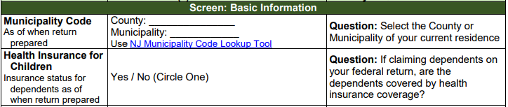
NJ Health Insurance for Dependents
NJ informational question about health insurance coverage for dependents
  Does not impact NJ income tax in any way
  Used so that NJ can contact people about health insurance through Children’s Health Insurance Program (CHIP) or Family Care
  Capture dependent health insurance information in NJ Checklist Basic Information section for later entry in TaxSlayer State section
Ray Caldwell - NJ Version - Young Married Couple

Slide 74
Box 14 – Excess NJ Special Tax Withholdings
NJ special taxes shown in W-2 Box 14 each have a maximum yearly withholding
  Unemployment, disability, and family leave insurance
If more than 1 employer, excess special taxes may be withheld
Excess taxes are reported on NJ 2450 and reclaimed on NJ 1040 lines 57-59
TaxSlayer handles this automatically from W-2 Data
Note: Form NJ-2450 will be generated only if there’s excess special tax withholding from 2 or more W-2’s. If there’s excess withholding from any single employer, the client must seek a reimbursement from the employer

Slide 75
NJ Taxability of Interest Income
NJ does not always follow Federal taxability rules for interest
  See NJ GIT-5 for list of taxable and tax-exempt obligations (Available from NJ Division of Taxation website)

Slide 76
NJ Tax Rules for Taxability (GIT-5)
NJ Exempt
  Most federal obligations
  DC, Puerto Rico, Virgin Islands, US Possessions
  NJ issued individual bonds
  NJ obligations if in a mutual fund which is a Qualified Investment Fund ( > 80% NJ exempt)
NJ Taxable
  Bonds issued by states other than NJ
  NJ obligations if in a mutual fund which is not a Qualified Investment Fund (< 20% NJ exempt)

Slide 77
Summary of Tax Exempt – Federal vs NJ
Interest Type | Exempt From Federal Tax | Exempt From NJ Tax
Interest from U.S. Savings Bonds |  | √
Interest from NJ state/municipal bonds | √ | √
Interest from state/municipal bonds other than NJ | √

Slide 78
Adjustments for Differences in Federal vs. NJ
Adjustments need to be made in Taxslayer for differences when entering the 1099-INT
Income is tax exempt for Federal and taxable for NJ
  For example, bonds from states other than NJ
  Click “Add Interest Items” on Interest Income screen to add it to state income
  Select NJ as state and enter taxable amount

Slide 79
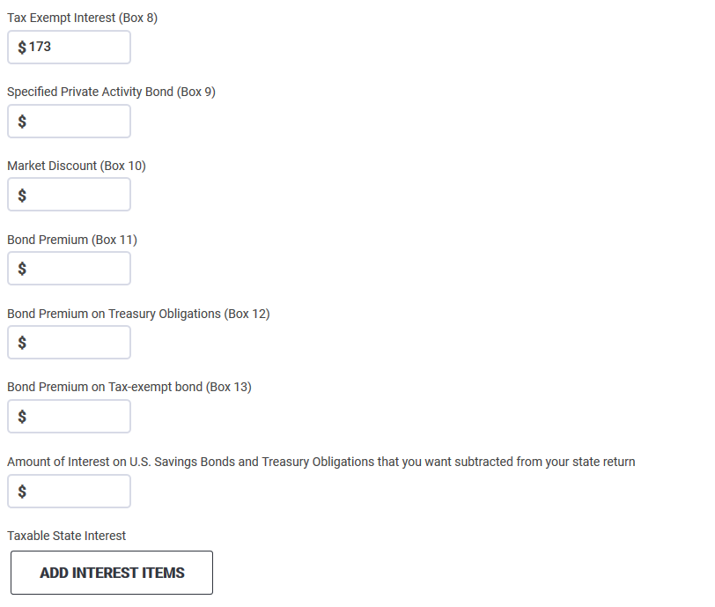
Entering 1099-INT for Obligation of Another State
Tax Exempt for Federal, Taxable for NJ
Tax-exempt for Federal
Click to add to New Jersey State Return

Slide 80
Adjustments for Differences in Federal vs. NJ cont’d
Income is taxable for Federal and tax exempt for NJ
  For example, US government bond
  Enter amount to be subtracted from NJ income on the Interest Income screen

Slide 81
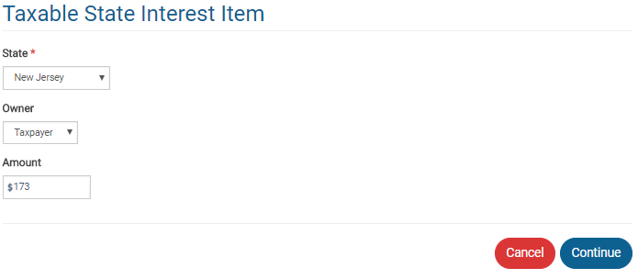
Entering 1099-INT for Obligation of Another State
Tax exempt for Federal, Taxable for NJ
Federal tax exempt amount that is taxable for NJ

Slide 82
1099-INT on Brokerage Statement
Summary of potentially many individual transactions
  Only summary values need to be entered on TaxSlayer Interest screen
    Use name of Brokerage as payer
  Detail transactions backing up summary data are usually listed on later pages in statement
  If there is a tax-exempt interest amount (Box 8), then that amount is tax exempt federally, but you may need to examine detail to determine how much is tax exempt for New Jersey
    Tax-exempt mutual funds should have a breakdown of tax-exempt percentages by state

Slide 83
Exempt Interest Dividends from Mutual Funds
Tax exempt on Federal return
Taxability varies for NJ, depending on bonds held by fund (look at statement detail pages)
  Interest attributable to Federal obligations (including P.R., territories, etc.) always tax exempt
  Interest attributable to other states except NJ always taxable
  Interest attributable to NJ bonds only tax exempt if fund is “NJ Qualified Investment Fund” (usually has NJ in name of fund)
    Interest on NJ bonds held individually by taxpayer (not in a mutual fund) always tax exempt

Slide 84
Entering Exempt Interest Dividends in TaxSlayer
Enter full amount of Federal Exempt Interest Dividends from Box 10 on Dividend Income screen
Brokerage statement usually provides percentages of bonds in different categories (i.e. – Federal, each state). Apply those percentages to Federal Exempt Interest Dividends amount as appropriate
Click “Add Dividend Items” to add a Taxable State Interest Item screen
If Federal or multi-state fund, add all non-Federal amounts (including NJ amounts) as amount that is taxable for NJ
If fund is NJ specific, add only amount from states other than NJ as amount that is taxable for NJ

Slide 85
IRAs, 403b, 457b, Thrift Savings Plans: NJ Considerations
Federal rules
  Contributions to these plans are usually deductible in year made
  Therefore, distributions are taxable when withdrawn
NJ rules
  Contributions are not deductible in the year made
  Therefore, amount of contributions may not be taxable when distributed (if records kept)
  Earnings accumulate tax deferred, but earnings taxed when distributed
Contributions to 401k plans are pre tax in NJ starting 1/1/84, so distributions from 401ks are taxable just like Federal
Taxable amounts from Federal 1040 retirement lines transfer to NJ 1040, so must calculate different NJ taxable amounts and capture on NJ Checklist

Slide 86
Rules on Taxability Of Retirement Income - NJ
Contribution | Taxable at Contribution | Taxable at Distribution
Employer contributions | N/A | YES
Employee contributions paid with pre-tax dollars to 401K | NO | YES
Employee contributions paid with after-tax dollars (including IRA) | YES | NO
Earnings on both employer & employee contributions | N/A | YES

Slide 87
IRAs, 403b, 457b, Thrift Savings Plans
To determine NJ taxable amount of any of these distributions, the portion of the distribution that represents taxpayer contributions is allocated over expected number of distribution years
Taxpayer must know total contributions
  May be able to get info for some of these plans from NJ Division of Pensions and Benefits. Taxpayers would have to know IRA contributions from their own records
Use NJ IRA Worksheet on TaxPrep4Free.org to determine the taxable and nontaxable amounts (if contributions are known)
Calculate adjustment needed to amount on NJ retirement line that flowed through from Federal to reflect the NJ taxable amount
  Capture on NJ Checklist as Adjustment to Line 20a
Capture non-taxable amount on NJ Checklist as Adjustment to Line 20b

Slide 88
Business Income: NJ Considerations
When Schedule C is completed, NJ BUS 1 & 2 will be automatically created in the NJ section
  If within scope for Sch C, no action is required on the NJ forms

Slide 89
Questions
Answer Caldwell questions 17

